Slide 1
AI based Garbage separator
SUBMITTED BY
VISHWA PARIKH 17082251011

Slide 2
INTRODUCTION
Technology has improved the quality of life and given birth to an advanced form of life. This has varying impact on the environment and other lives on the earth. For instance, water bottles made of plastic, which is convenient to use and carry but its disposal is a challenge for nature. There are lots of waste materials which are degradable and non- degradable.
Therefore, categorization and proper disposal of waste are necessary. Waste materials can be classified as biodegradable and non-biodegradable.
Thus with the help of our project the separation of wastes can be detected.

Slide 3
OBJECTIVE
Excel waste separating Biodegradable and Non-Biodegradable waste to migrate the dropdown of the waste disposal.

Slide 4

Project Profile-
Project on - AI based Garbage seperator
Internal Guide – prof. Kashyap Patel
Submitted by – Vishwa Parikh
Submitted to -

Slide 5
REQUIREMENTS
Hardware used:-
Camera Hardware (live IP cam)
Operating System:-
Android/Linux/Windows operating system dedicated hardware for running software

Slide 6
TOOLS AND TECHNOLOGY
Software Used :
- keras, tensorflow, flask, python
Programing used:
- HTML/CSS/JS
Platform:
-Google Colab
-Anaconda(Spyder)

Slide 7
INDEX
No. | Title
1. | Introduction
2. | Objective
3. | Requirements
4. | Tools and Technology
5. | Conclusion
6. | Bibliography

Slide 8
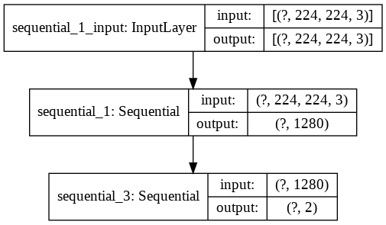
WORKING OF IMAGES IN MODEL

Slide 9
Building a Convolutional Neural Network (CNN) in Keras.
A great way to use deep learning to classify images is to
build a convolutional neural network (CNN).
The Keras library in Python makes it pretty simple to build
a CNN.
CNN Computers see images using pixels.

Slide 10
A toy ConvNet: X’s and O’s
Says whether a picture is of an X or an O
A two-dimensional
array of pixels
CNN
X or O

Slide 11
For example
CNN
X
CNN
O

Slide 12
Trickier cases
CNN
X
translation
scaling
rotation
weight
CNN
O

Slide 13
Deciding is hard
?
=

Slide 14
What computers see
?
=

Slide 15
What computers see

Slide 16
Computers are literal
=
x

Slide 17
ConvNets match pieces of the image
=
=
=

Slide 18
Features match pieces of the image

Slide 24
Filtering: The math behind the match

Slide 25
Filtering: The math behind the match
Line up the feature and the image patch.
Multiply each image pixel by the corresponding feature pixel.
Add them up.
Divide by the total number of pixels in the feature.

Slide 26
Filtering: The math behind the match
1 x 1 = 1

Slide 27
Filtering: The math behind the match
1 X 1 = 1

Slide 28
Filtering: The math behind the match
-1 x -1 = 1

Slide 29
Filtering: The math behind the match
-1 x -1 = 1

Slide 30
Filtering: The math behind the match
-1 x -1 = 1

Slide 31
Filtering: The math behind the match
1 x 1 = 1

Slide 32
Filtering: The math behind the match
-1 x -1 = 1

Slide 33
Filtering: The math behind the match
-1 x -1 = 1

Slide 34
Filtering: The math behind the match
-1 x -1 = 1

Slide 35
Filtering: The math behind the match
1 x 1 = 1

Slide 36
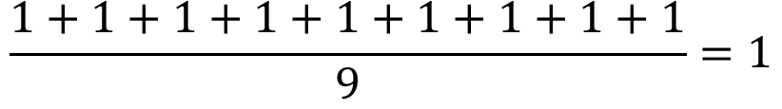
Filtering: The math behind the match
$$\frac{1+1+1+1+1+1+1+1+1}{9}=1$$

Slide 37
Filtering: The math behind the match
1 x 1 = 1

Slide 38
Filtering: The math behind the match
-1 x 1 = -1

Slide 39
Filtering: The math behind the match

Slide 40
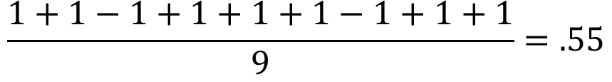
Filtering: The math behind the match
$$\frac{1+1−1+1+1+1−1+1+1}{9}=.55$$
.55

Slide 41
Convolution: Trying every possible match

Slide 42
Convolution: Trying every possible match
=

Slide 43
=
=
=

Slide 44
Convolution layer
One image becomes a stack of filtered images

Slide 45
Convolution layer
One image becomes a stack of filtered images

Slide 46
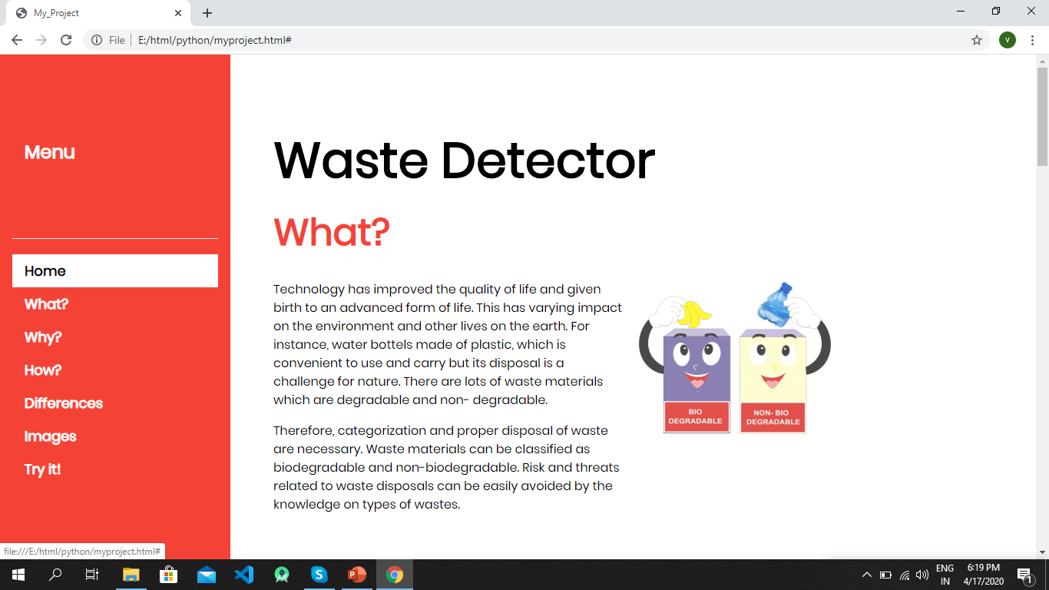
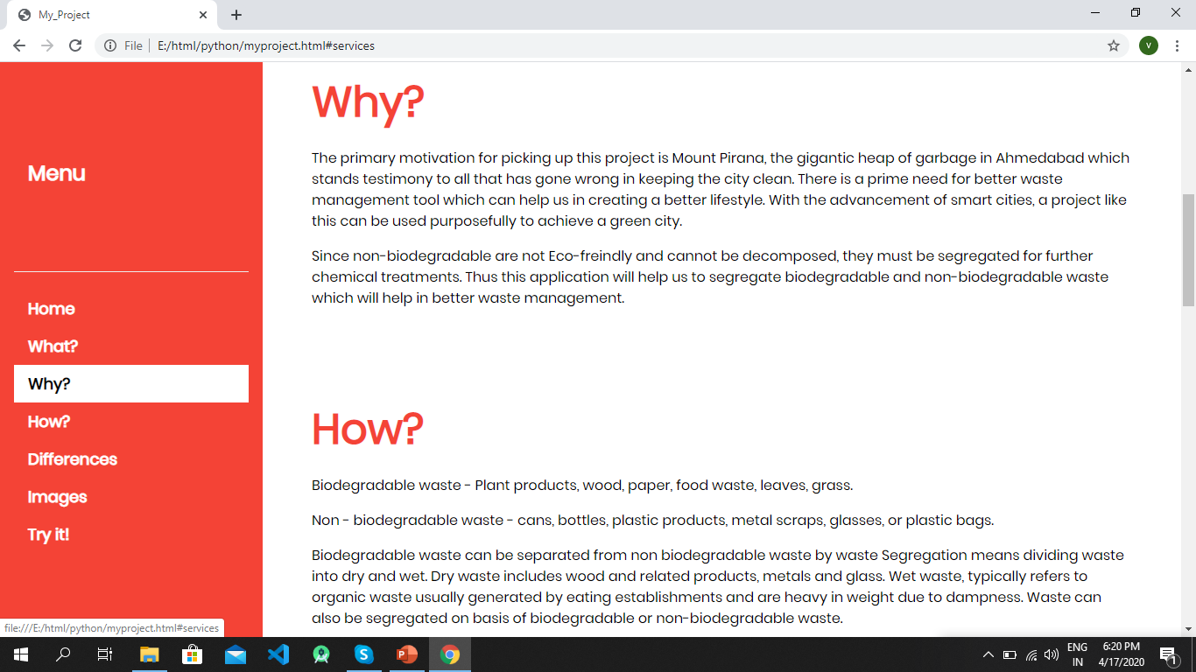
Screenshots of project

Slide 47
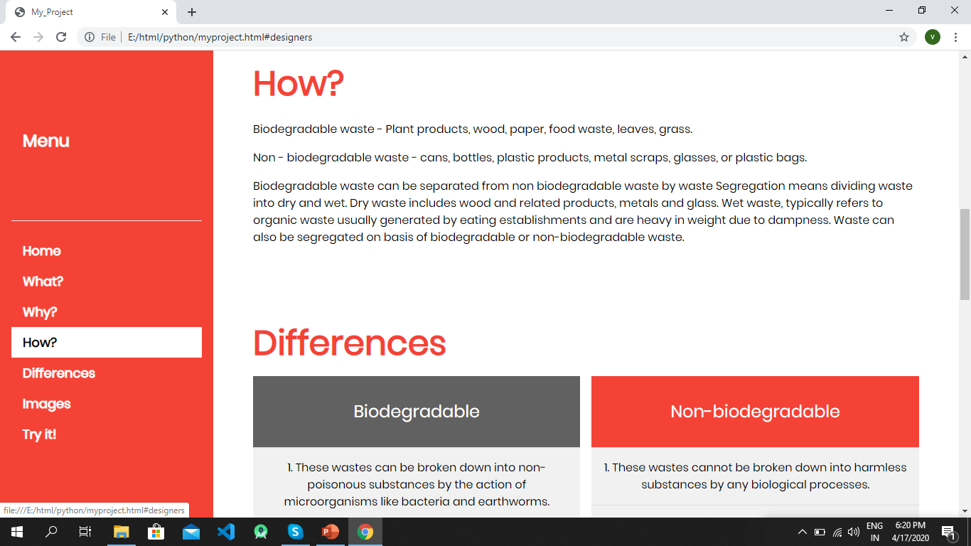
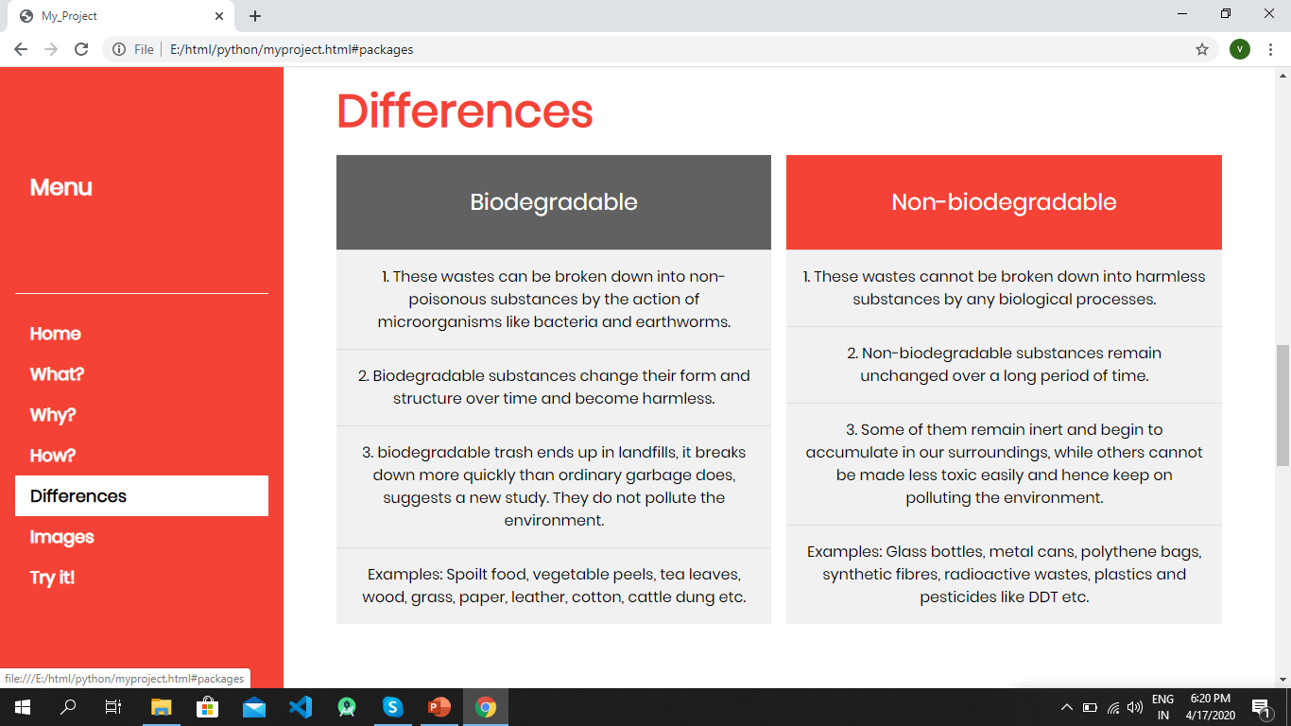

Slide 48
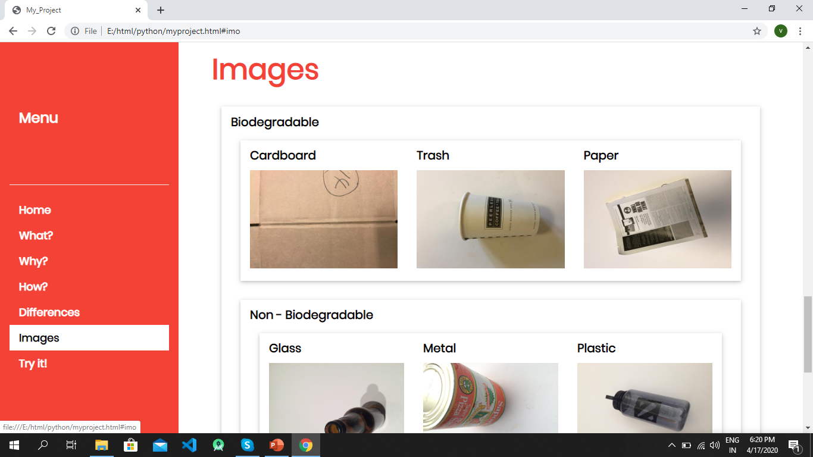
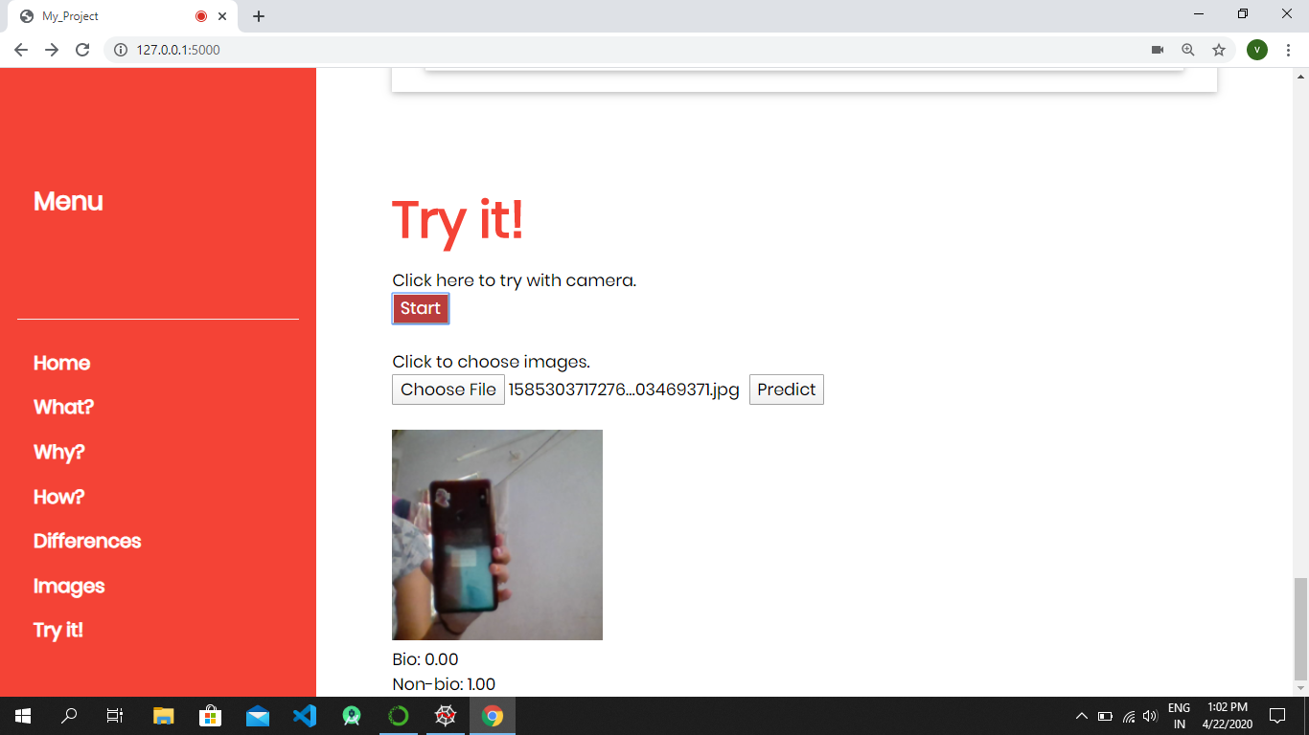

Slide 49
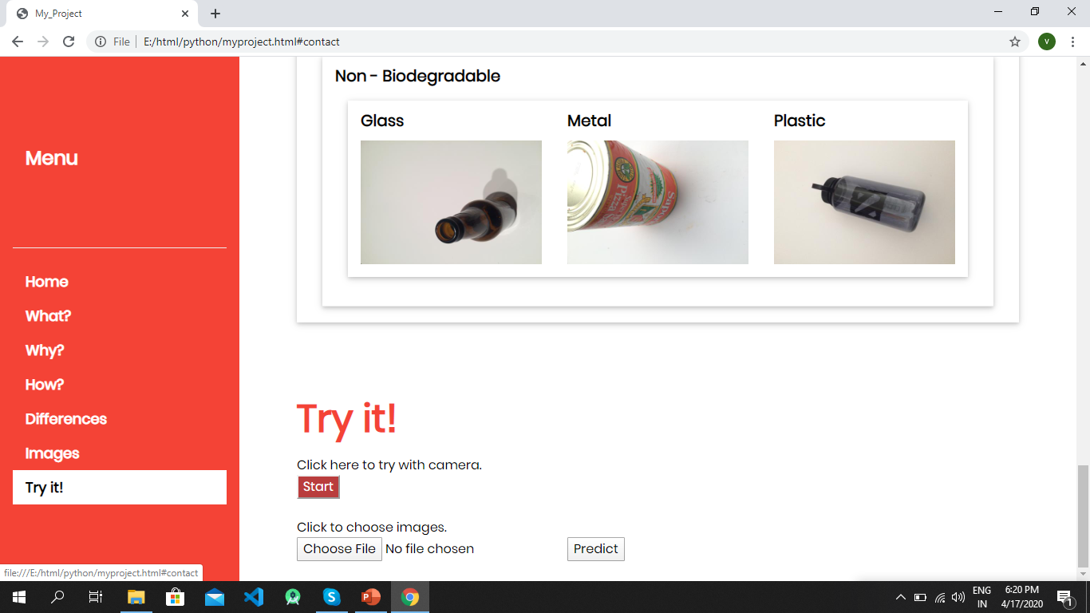


Slide 50
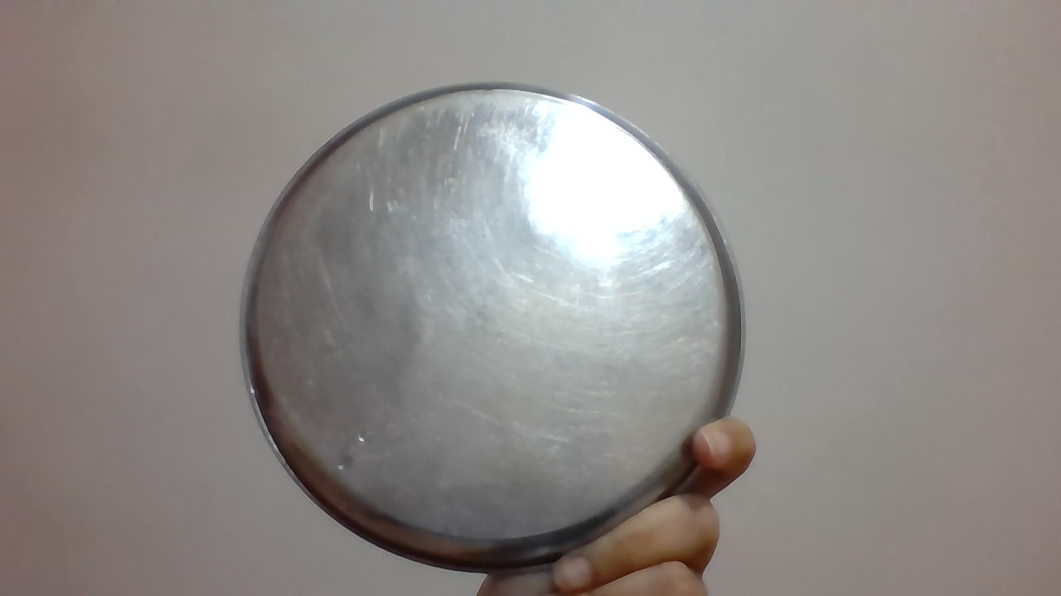
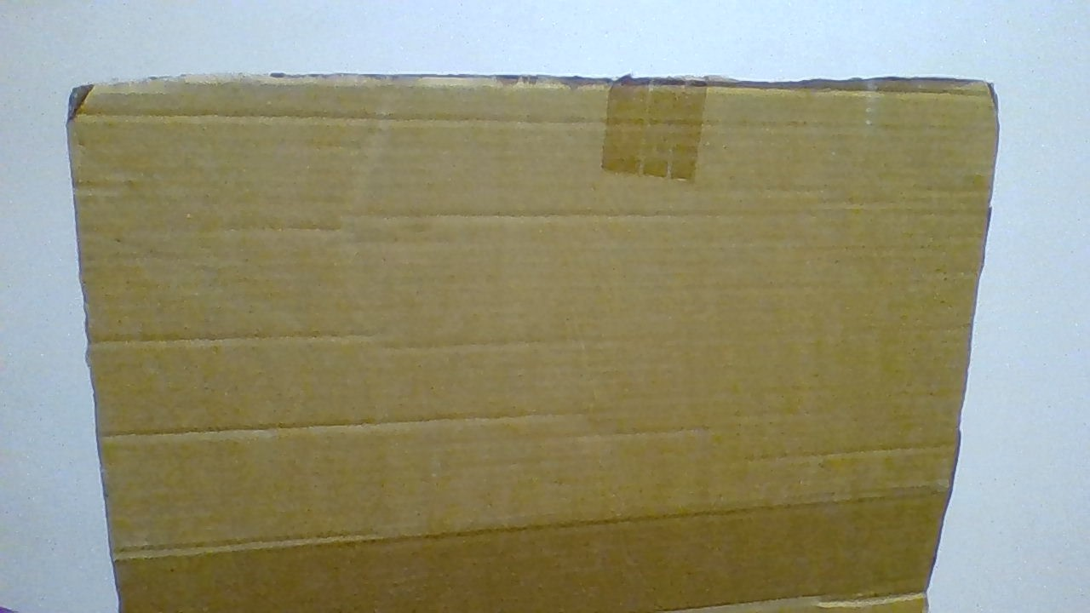

Slide 51
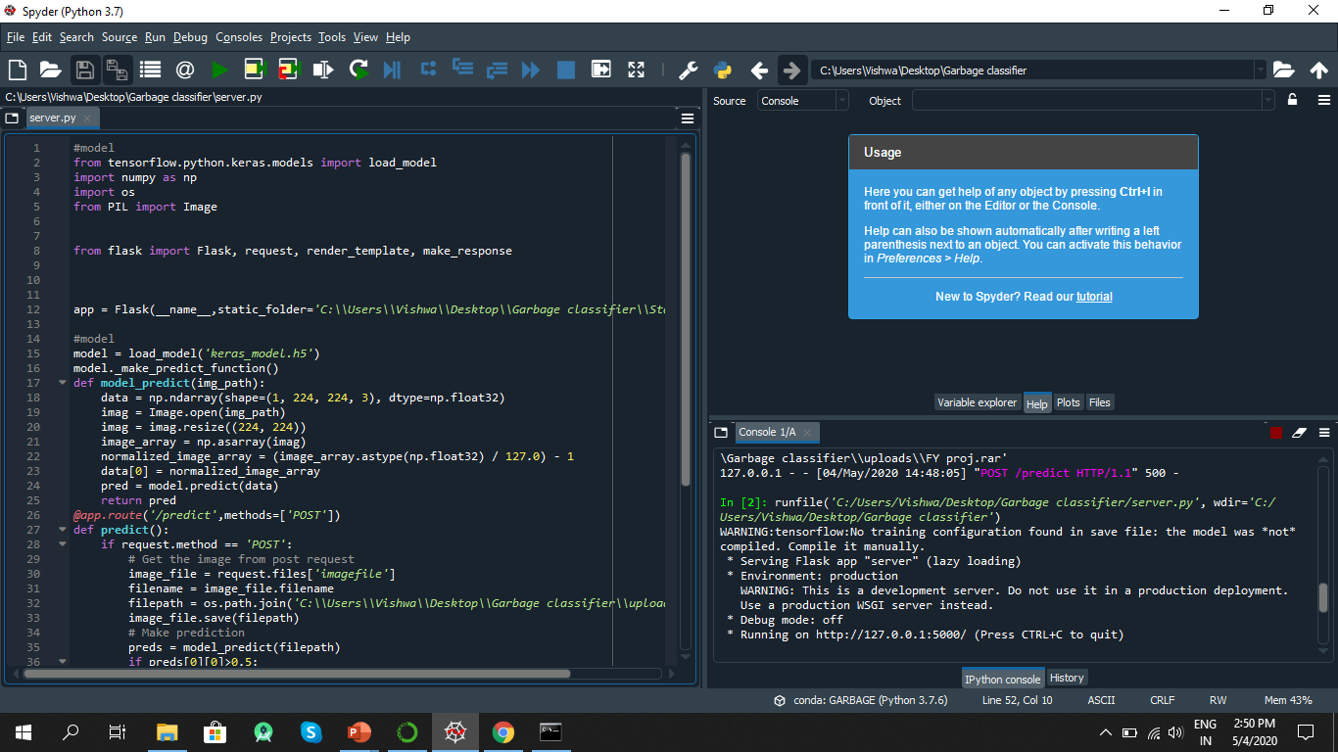

Slide 52
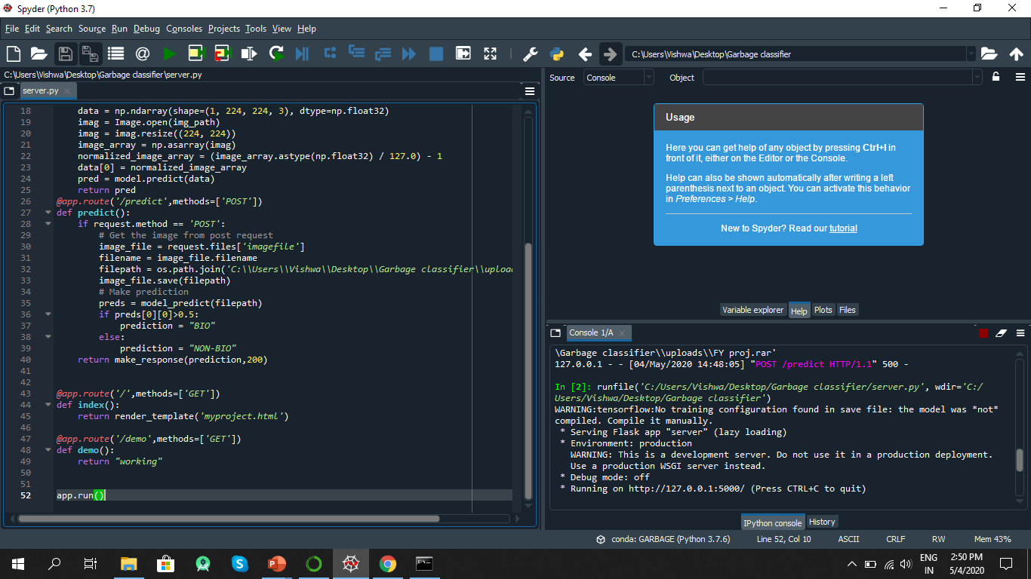

Slide 53
CONCLUSION
We have proposed a garbage classified system which can be used excitabilty by taking in images/videos the model we made is lite into a run a execute we have a integrated our model into web-site to demonstrate in an understand lable.

Slide 54
BIBLIOGRAPHY
https://teachablemachine.withgoogle.com/models/Iu6ZbI6Jo/
Keras.io

